Slide 1
Spring Boot + Microservices
Vivek Gohil

Slide 2




What are Microservices ?
To understand microservices, lets imagine a bank called EazyBank.
Typically, banks comprise various departments, including Accounts, Cards, Loans.

Slide 3
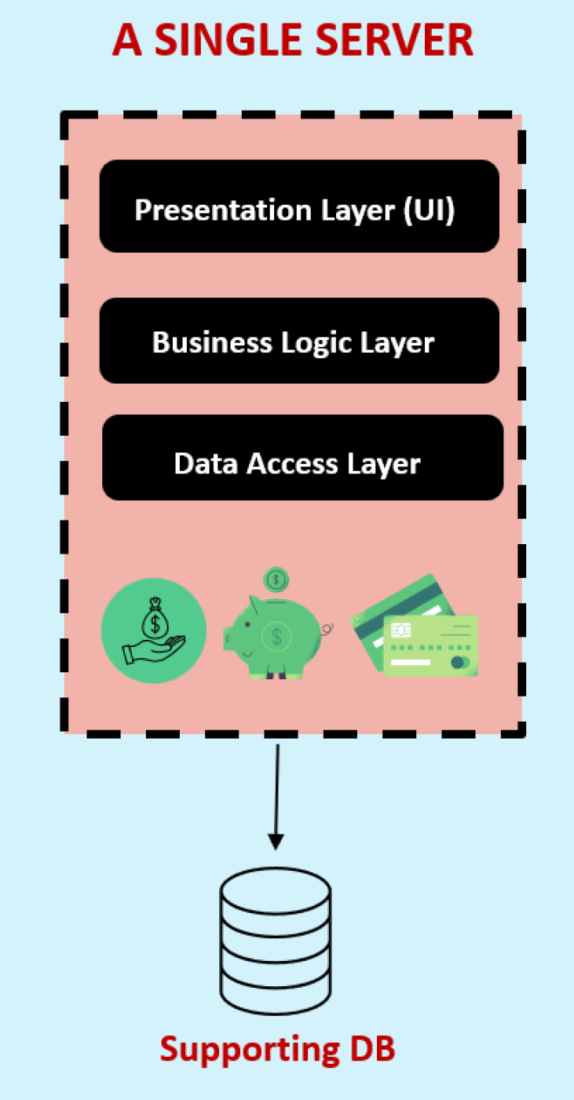
The Monolith
Back a decade, all the applications used to be deployed as a single unit where all functionality deployed together inside a single server.
We call this architecture approach as Monolithic.

Slide 4
The Monolith
Pros
Cons
Simple development and deployment for smaller teams and applications
Fewer cross-cutting concerns
Better performance due to no network latency
Difficult to adopt new technologies
Limited agility
Single code base and difficult to maintain
No fault tolerance
Tiny update and feature development always need full deployment

Slide 5

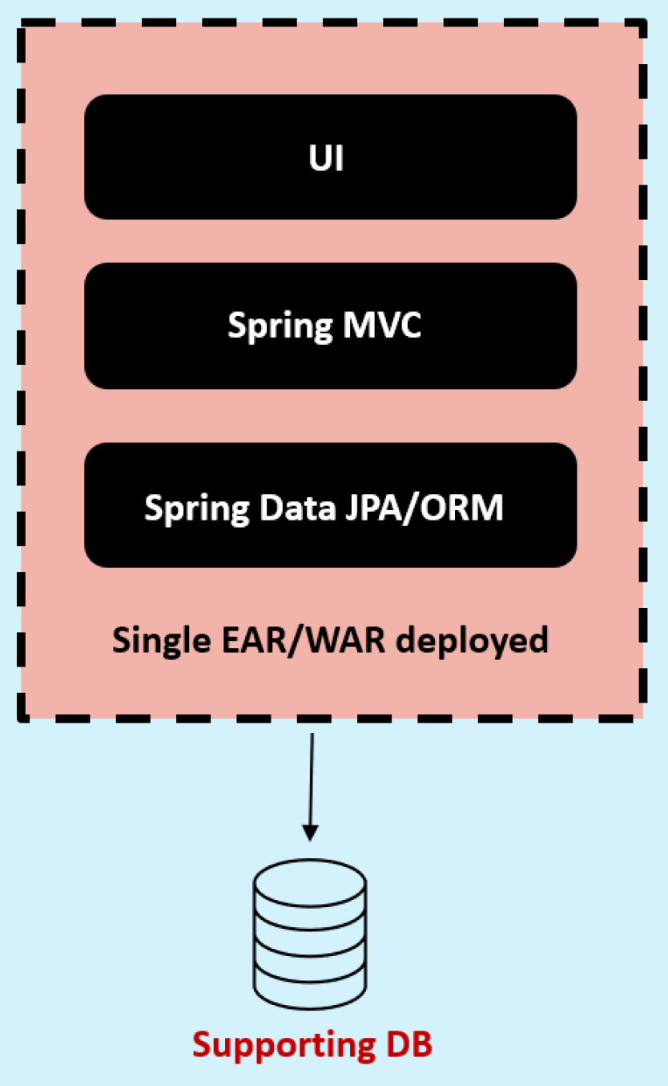





The Monolith
Accounts Dev Team
Single Code Repo
CI/CD
Loans Dev Team
In a monolithic approach, developers work with single code base which is then packed as unified unit, such as an EAR/WAR file and deployed into a single web/application server. Additionally the entire application is supported by a single database.
Cards Dev Team
UI/UX Dev Team

Slide 6
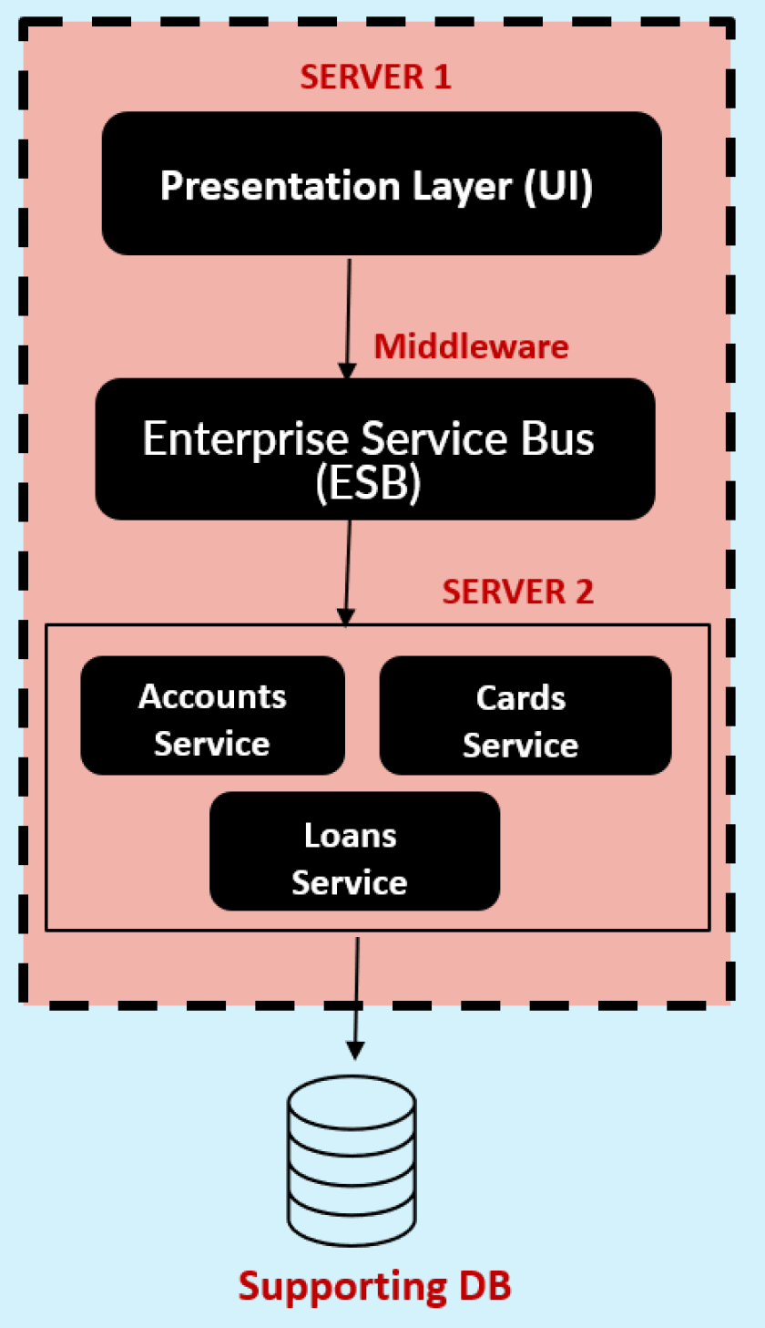
The SOA (Service-Oriented Architecture)
SOA emerged as an approach to combat the challenges of large, monolithic applications.
It is an architectural style that focuses on organizing software systems as a collection of loosely coupled, interoperable services.
It provides a way to design and develop large-scale applications by decomposing them into smaller, modular services that can be independently developed, deployed and managed.

Slide 7
The SOA (Service Oriented Architecture)
Pros
Cons
Reusability of services
Better maintainability
Higher reliability
Parallel development
Complex management due to communication protocols(SOAP).
High investment costs due to vendor in middleware
Extra overload

Slide 8
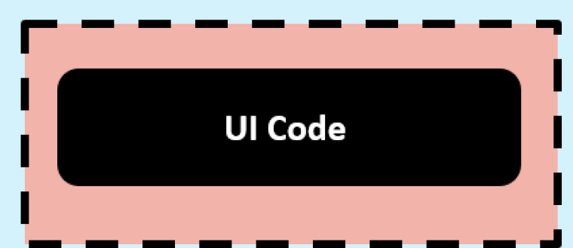

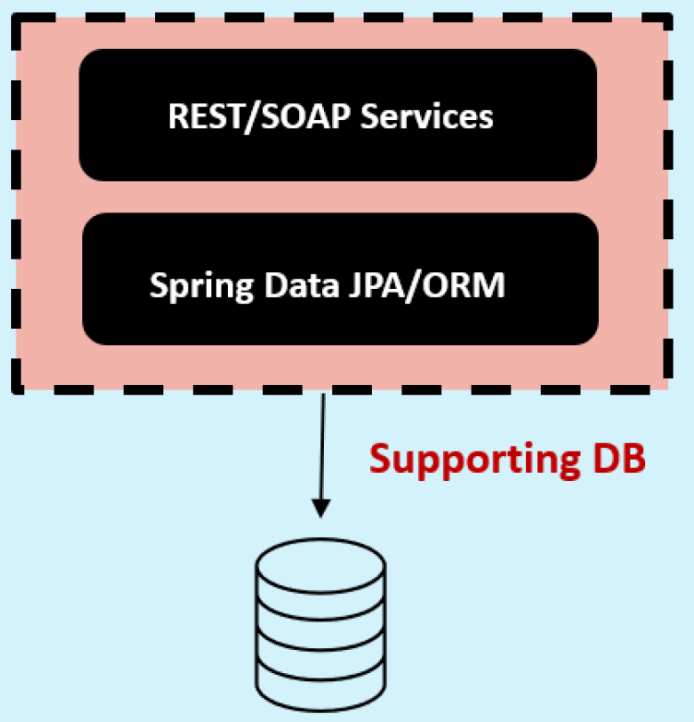
The SOA (Service Oriented Architecture)
Accounts Dev Team
UI code repo
Loans Dev Team
Cards Dev Team
Backend Services repo
SOA teams aimed to create smaller services, yet they remained tightly coupled to a shared database and required deploying everything as cohesive unit. While they followed a service oriented approach, it cannot be classified as microservices.
UI/UX Dev Team

Slide 9
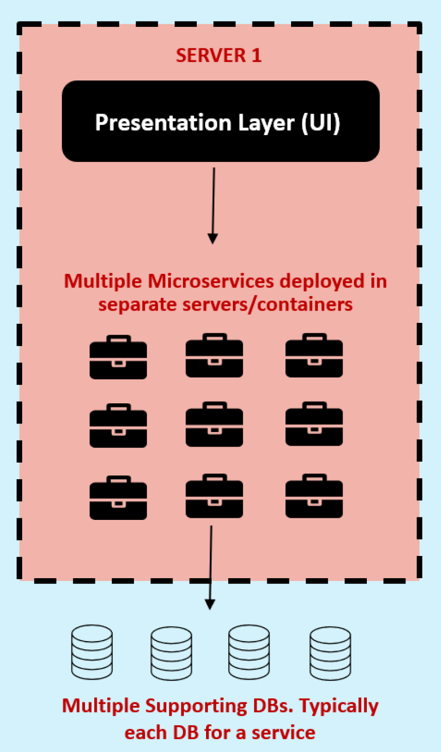
The Great Microservices
Microservices are independently releasable services that are modelled around business domain.
A service encapsulates functionality and makes it accessible to other services via networks – you construct more complex systems from these building blocks.
One microservice might represents Accounts, another Cards and yet another Loans, but together they might constitute an entire bank system.

Slide 10
The Great Microservices
Pros
Cons
Easy to develop, test and deploy
Increased agility
Ability to scale horizontally
Parallel development
Modelled around a business domain
Complexity
Infrastructure overhead
Security concerns

Slide 11
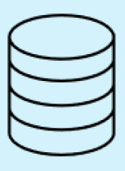

The Great Microservices
Invokes all the backend logic through REST API calls
UI APP
UI/UX Dev Team
Loans Dev Team
Loans DB
Cards Dev Team
Cards DB
Accounts Dev Team
Accounts DB

Slide 12
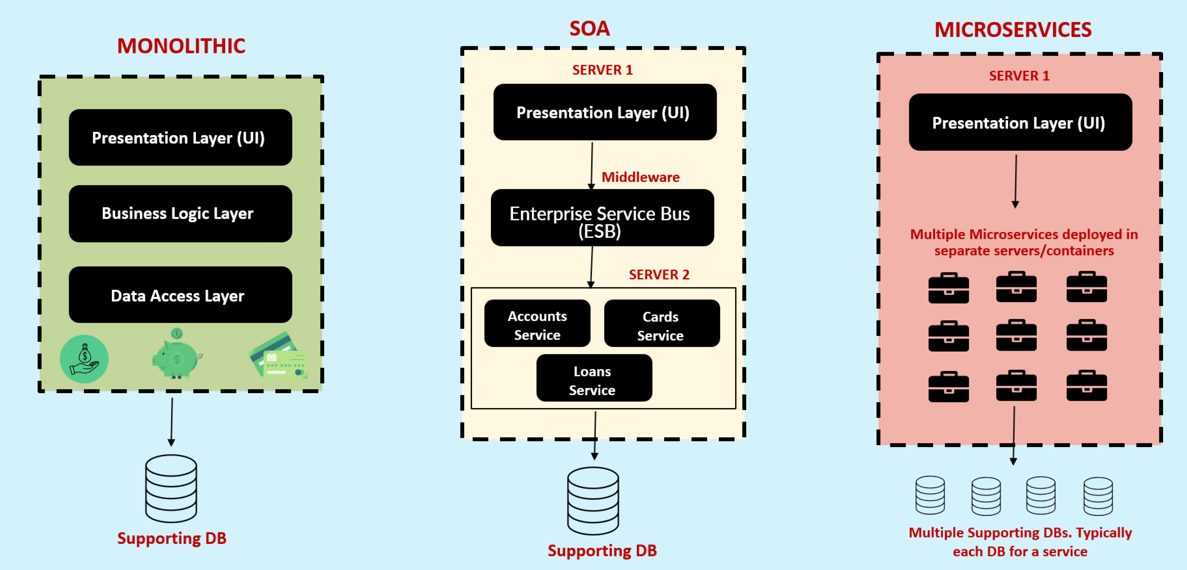
Monolithic vs SOA vs Microservices

Slide 13
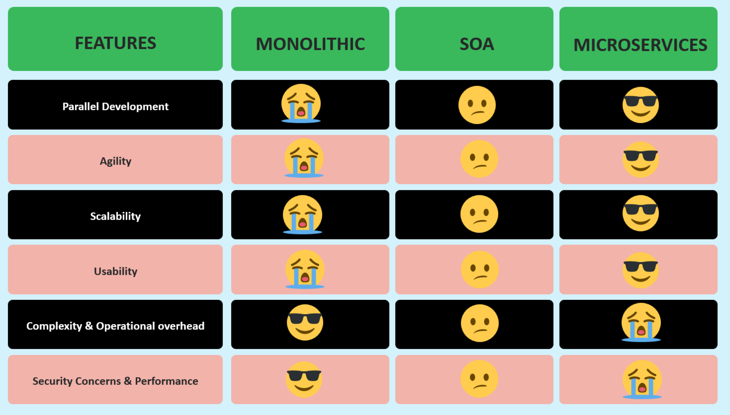
Monolithic vs SOA vs Microservices

Slide 14

Definition of Microservices ?
“Microservices is an approach to developing a single application as a suite of small services, each running in its own process and communicating with lightweight mechanisms, built around business capabilities and independently deployable by fully automated deployment machinery.” – From Article by James Lewis and Martin Fowler’s

Slide 15

How to build Microservices ?
When considering a web application, the traditional approach involves packaging it as WAR or EAR file.
These archive formats are commonly used to build Java applications, which are then deployed to web servers like Tomcat.
Do you think the same approach works for building microservices ?

Slide 16

How to build Microservices ?
Off course not, because organizations may need to build 100s of microservices. Building, packaging and deploying all the microservices using traditional methods can be an extremely challenging and practically impossible task.
How to overcome this challenge ?
The clue is Spring Boot

Slide 17
Why Spring Boot for Microservices ?
Spring Boot is a framework that simplifies the development and deployment of Java/Spring applications, including microservices.
With Spring Boot, you can build self-contained, executable JAR files instead of traditional WAR or EAR files.
Theses JAR files contains all the dependencies and configurations required to the microservices.
This approach eliminates the need for external web servers.

Slide 18
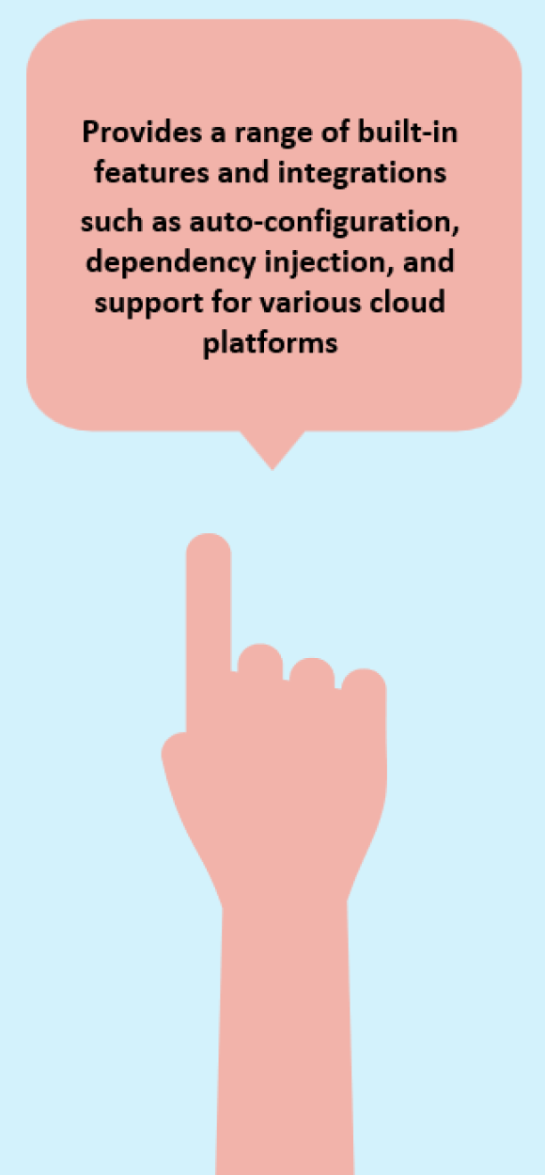
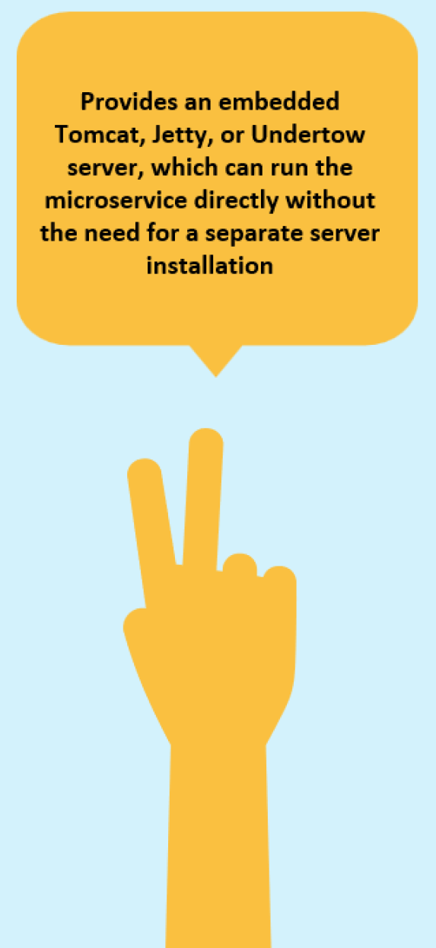
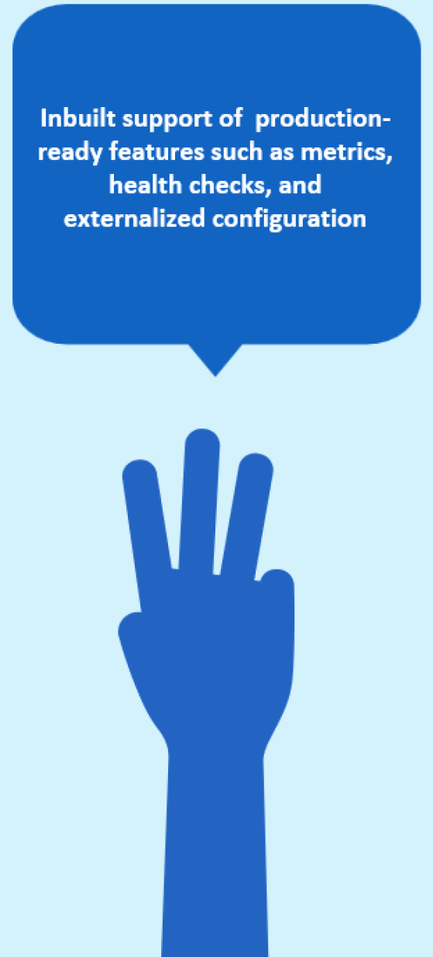
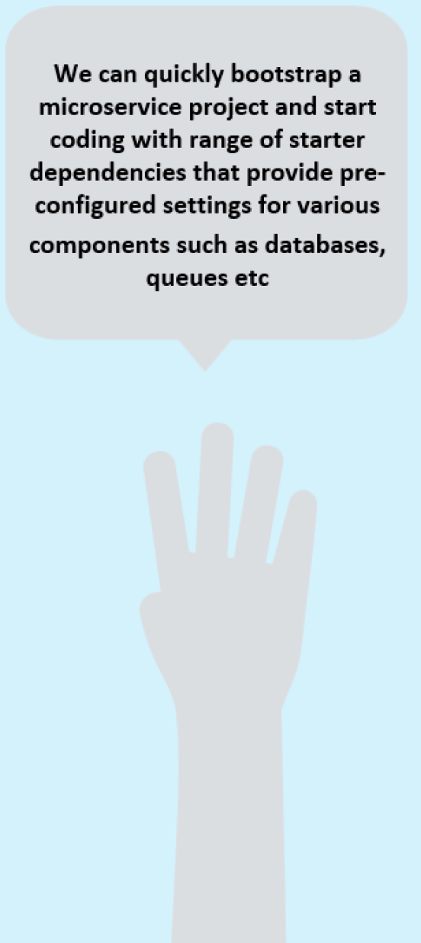
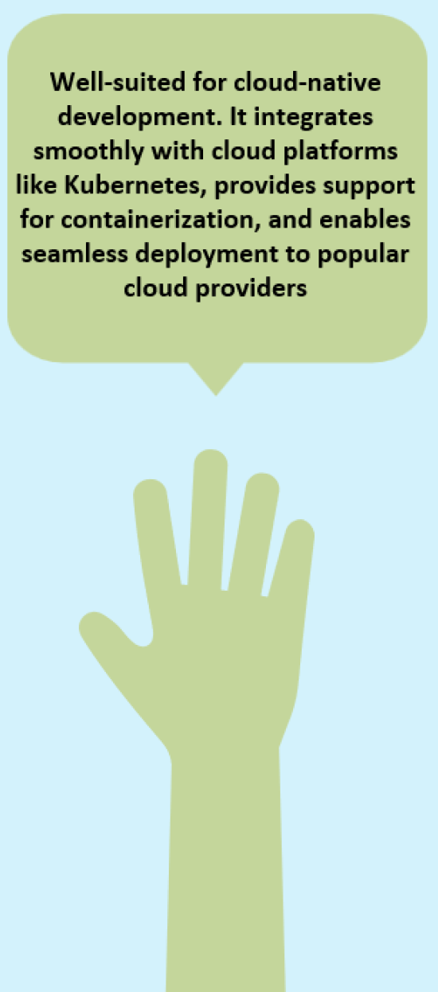
Why Spring Boot for Microservices ?

Slide 19
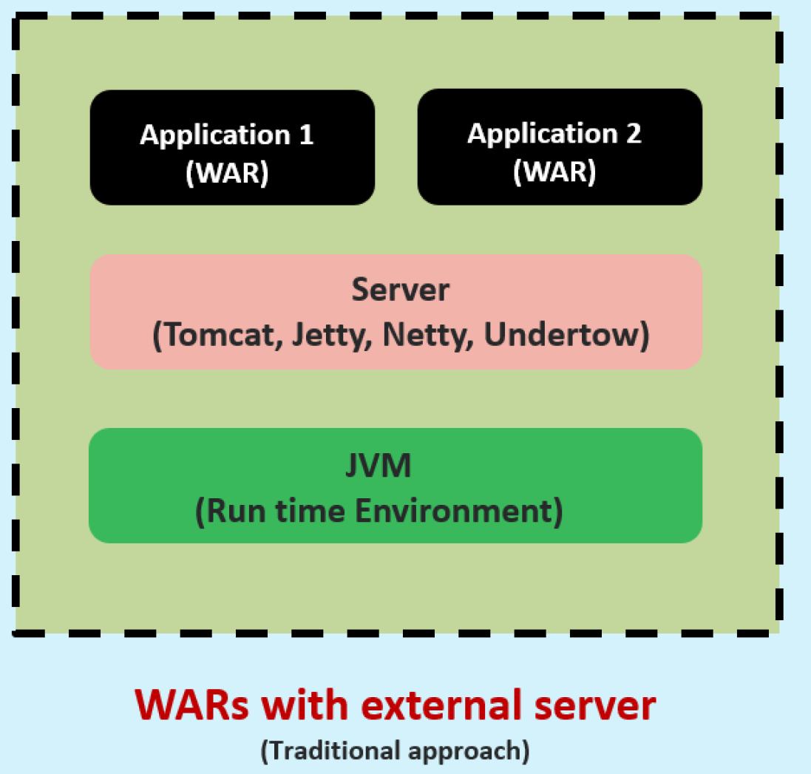
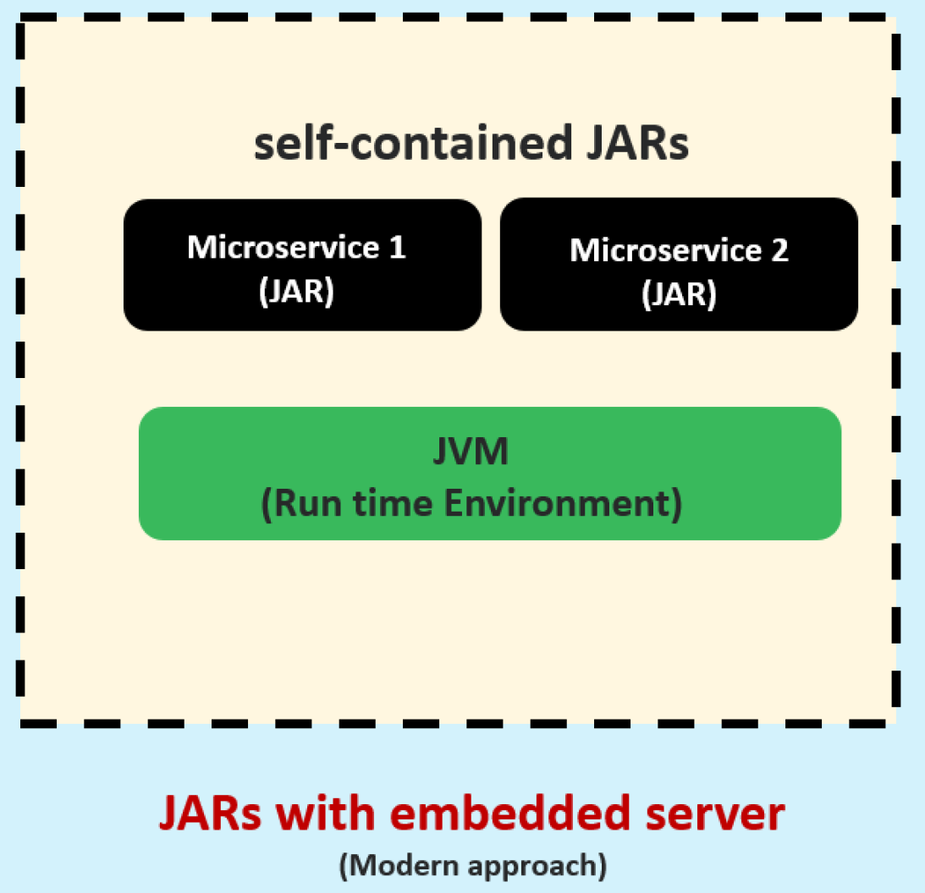
Why Spring Boot for Microservices ?
In the traditional approach, applications are typically packed as WARs and rely on the presence of a server in the execution environment for running. However, in the microservices paradigm, applications are packed as self-contained JARs, also called fat-JAR, since they contain the application itself, the dependencies and the embedded server

Slide 20
Implementing REST Services
REST (Representational State Transfer) services are one of the most often encountered ways to implement communication between two web apps.
REST offers access to functionality the server exposes through endpoints a client can call.

Slide 21
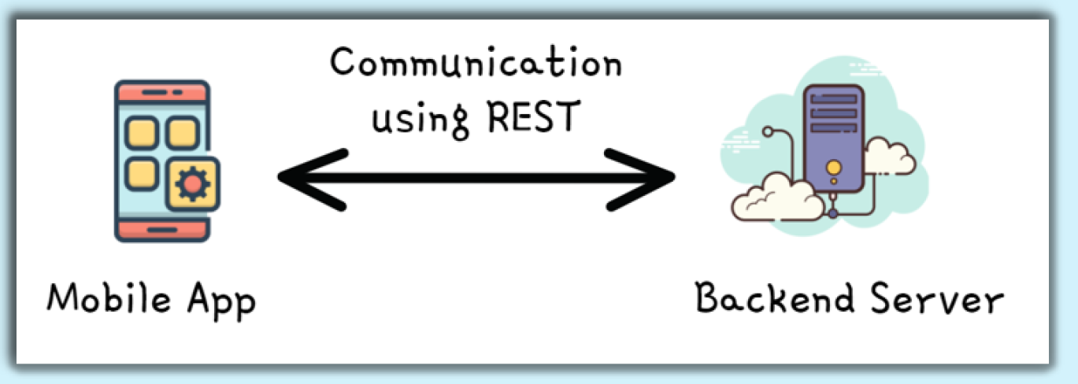
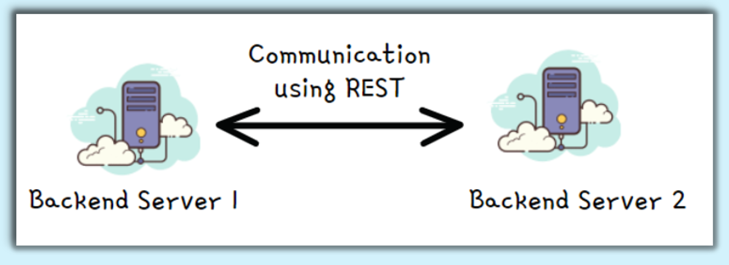
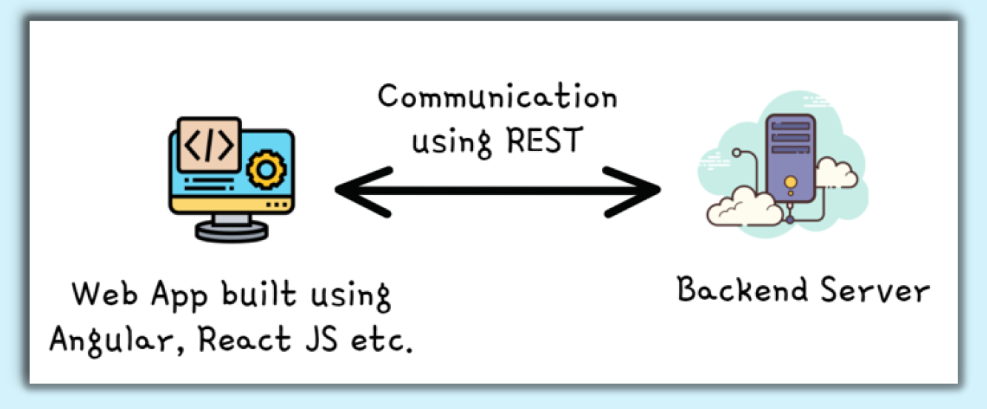
Implementing REST Service
Below are the different use cases where REST services are being used most frequently these days.

Slide 22
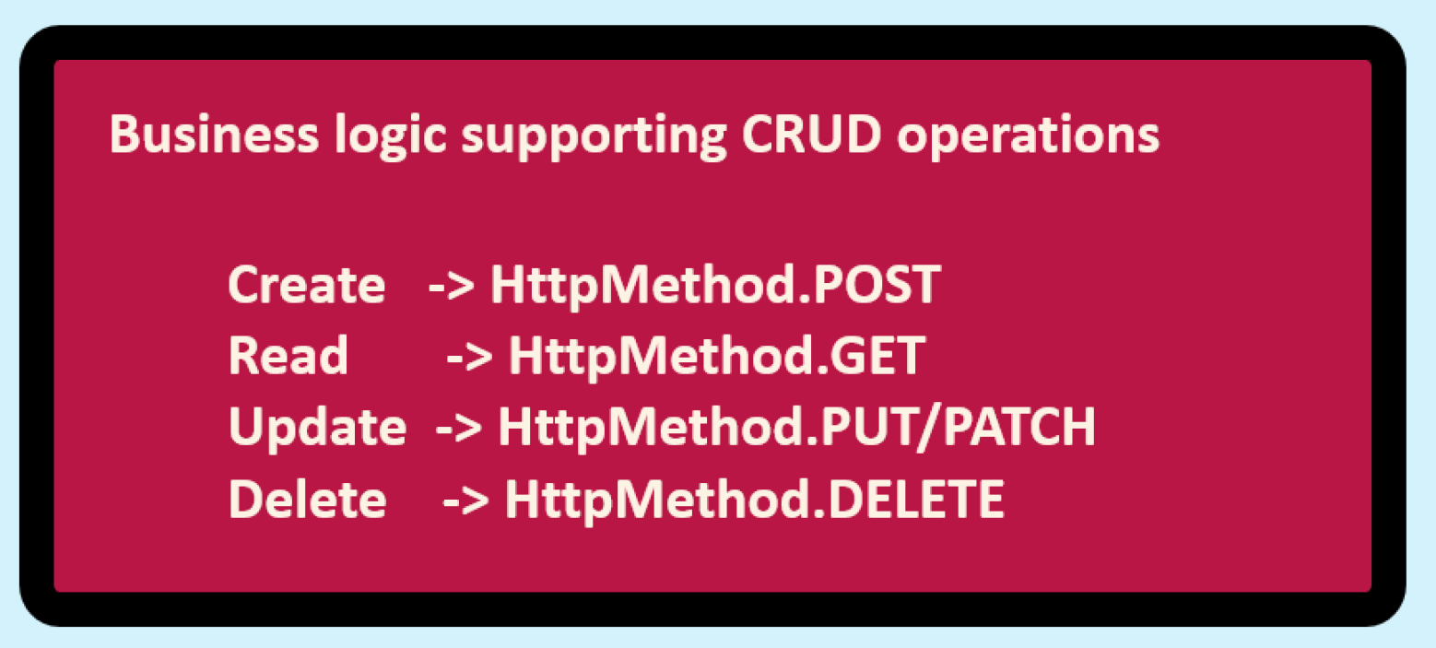
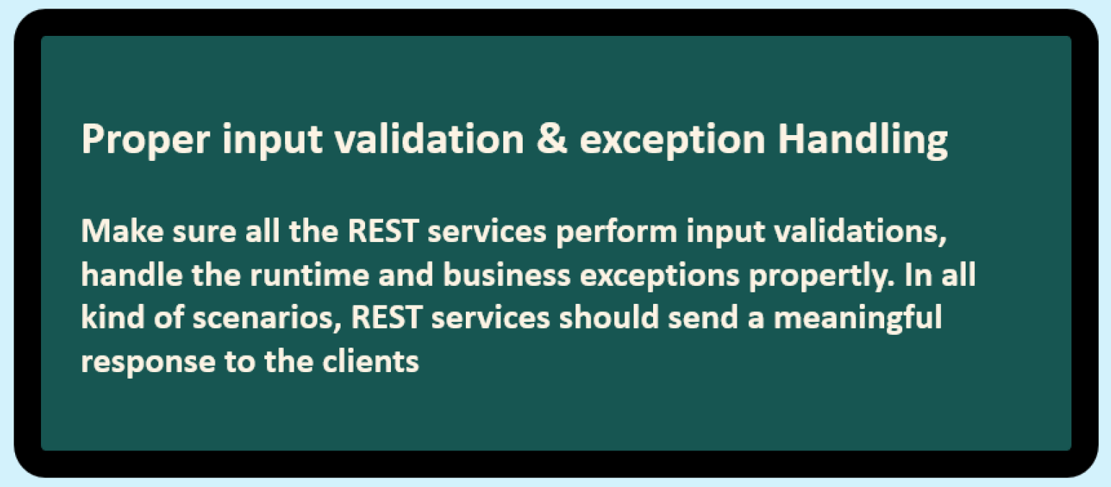
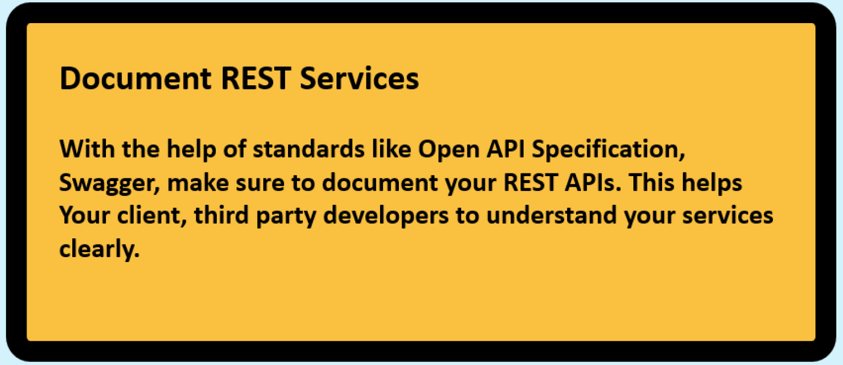
Implementing REST Service
Typically REST services are built to expose the business functionality and support CRUD operations on the storage system.
Attached are the standards that we need to follow while build REST services.

Slide 23
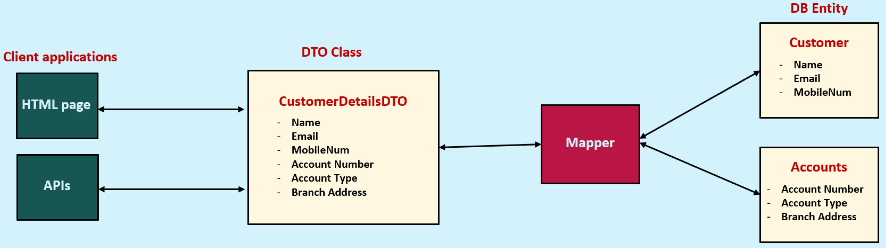
DTO (Data Transfer Object) Pattern
The Data Transfer Object(DTO) pattern is a design pattern that allows you to transfer data between different parts of your application.
DTOs are simple objects that contain only data, and they do not contain any business logic.
This makes them ideal for transferring data between layers of your application, such as the presentation layer and data access layer.

Slide 24
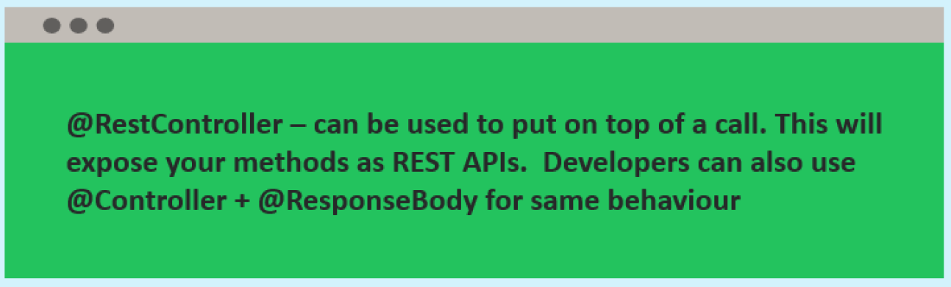
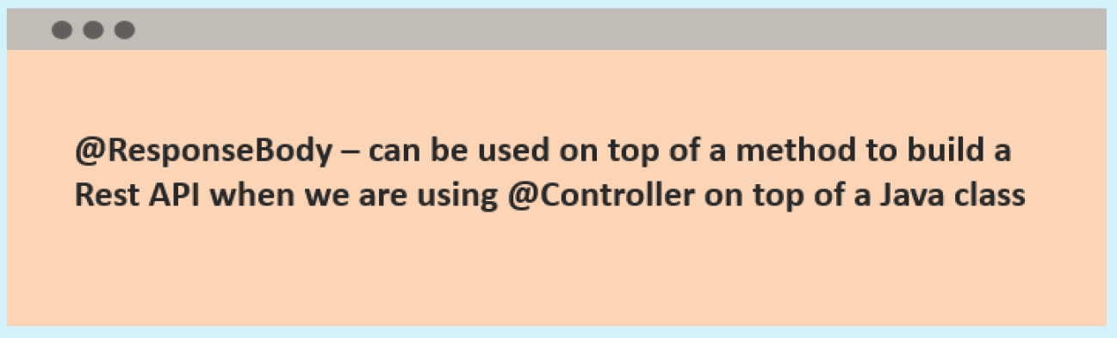
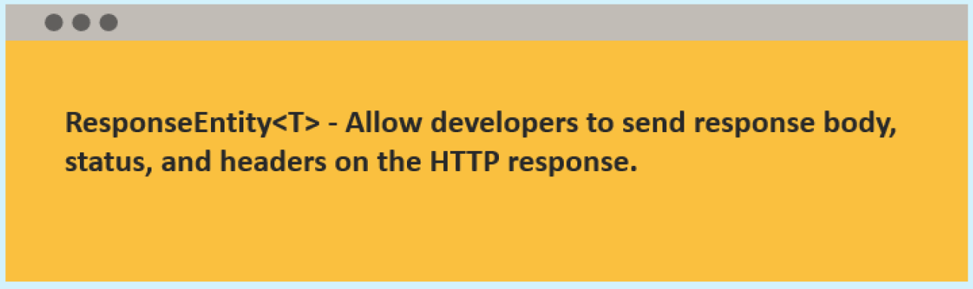
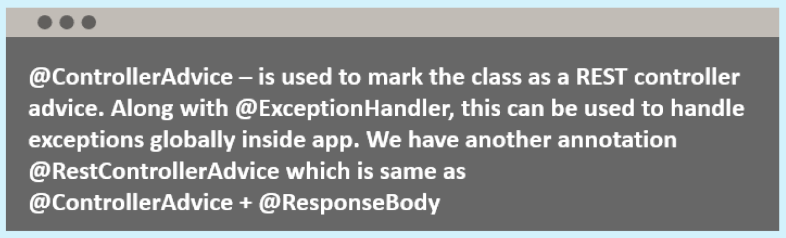
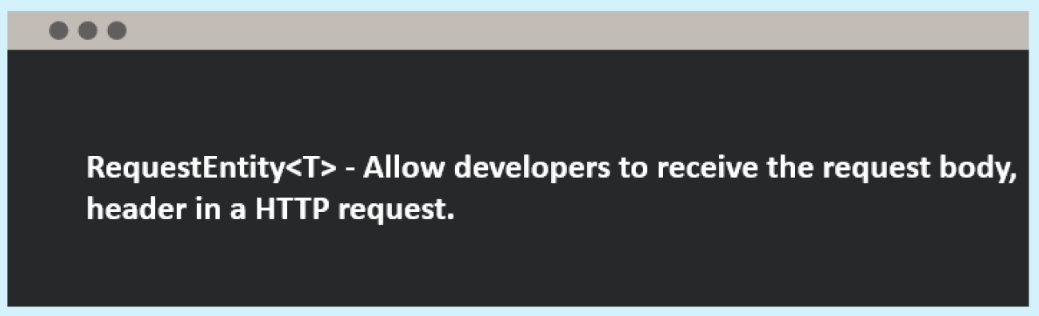

Different Annotations & Classes that supports building REST Services

